Slide 1




Comprehensive AI Architecture to Monitor and Predict Heart Rate during Physical Exercises
Team
Talia brooks
Aaron Bemis
Jack Morris
Alex Boyett
Lauren Bailey
Milestone 2 Report
IT Capstone 4983
Kennesaw State University
October 23th, 2022

Slide 2
Contents
I. Introduction
II. Team
III. Contents
IV. Summary
V. Milestone Assessment
VI. Project challenges
VII. Gantt chart
VIII. Future plan

Slide 3
Summary
Used branch of Machine Learning and Artificial Intelligence called Supervised Learning.
Supervised Learning is defined by IBM as "its use of labeled datasets to train algorithms to classify data or predict outcomes accurately".
In Milestone 2, we used Supervised Learning to predict labels for each data instance given the input features from our data from Milestone 1.
We predicted the average error between the predicted and true heart rates.
By: IBM Cloud Education. (n.d.). What is supervised learning? IBM. Retrieved October 21, 2022, from https://www.ibm.com/cloud/learn/supervised-learning

Slide 4
Summary
• In Progress A trained deep learning architecture that utilizes the person's information during exercises as well as environmental information to monitor and predict heart rates.
• Complete Milestone 1: A comprehensive dataset on heart rate during exercises with geo data: longitude, latitude, altitude and weather data: temperature, humidity, precipitation. (at least 1000)
• Complete Milestone 2: A construction of deep learning models based on generated data from milestone 1.
• In Progress Milestone 3: Tested and finetuned deep learning models from milestone 2.
• In Progress Milestone 3: Comparisons with other state-of-the-art methods in terms of accuracy.

Slide 5
Milestone 2 objectives
I. Process the model data to be able to predict the future heart rate of the user during their exercises from one data point to the next.
II. Figure out the parameters such as the size and number of blocks to run each of the model types (4 types of the same model for 4 models).
III. Use 4 different models. Each model has 4 sets of parameters that are adjusted for different runs. Each set of parameters runs 5 times to get an average heart rate prediction error rate.

Slide 6
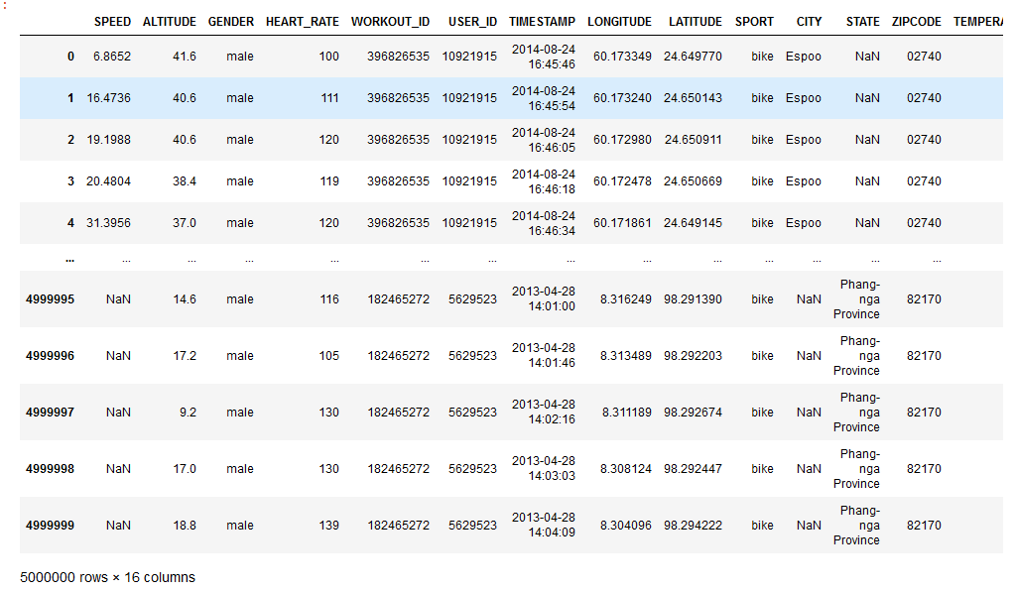
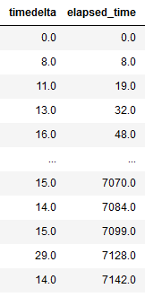
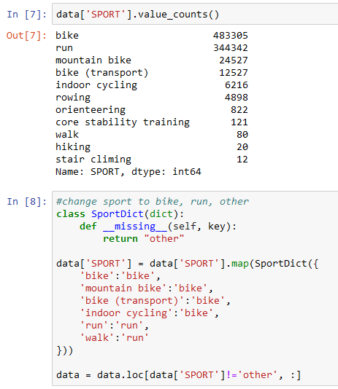
Processing the combined data from milestone 1
We took 10,000 exercise that had 500 datapoint and turned that into an object for our models to use.
This gave us 5 million data entries the models could run against.
Timestamps were converted to seconds, broken into differences from one piece of data to the next and a running total was tracked as well.
Similar exercises were then combined into single exercises. This would help the model lump everything into two distinct categories biking or running.
The model could then take that input and learn about biking heartrates and running heartrates separate since they do differ greatly.
During processing gender was converted to binary. For our models, female became 0, male became 1 and some users did not report gender. Having gender helps the model during the learning process because the model would learn how different genders affect heart rates.

Slide 7
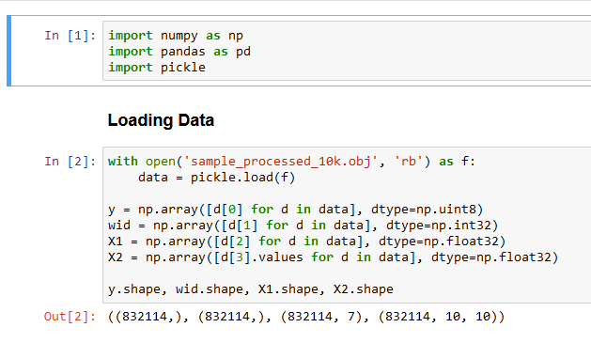
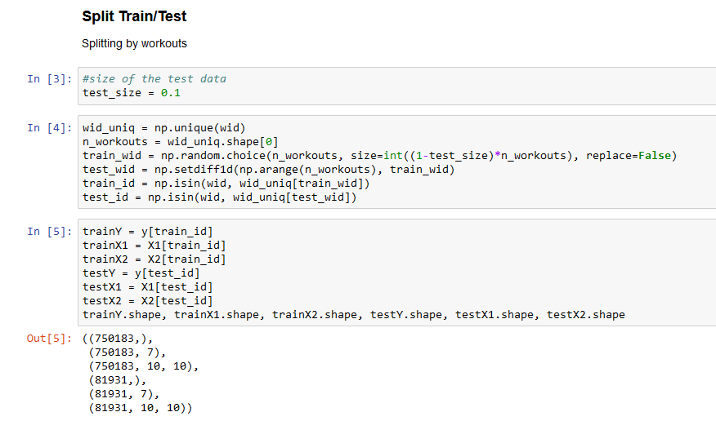
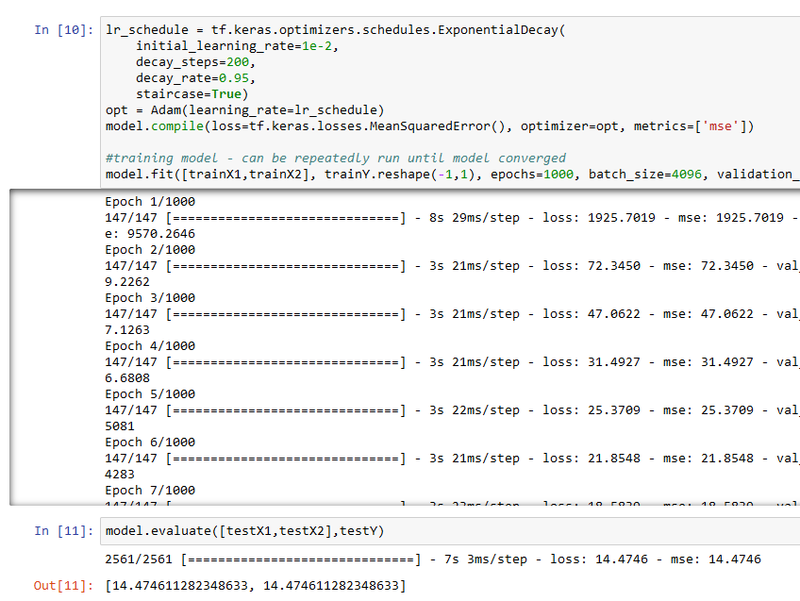
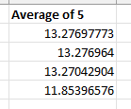

One-Dimensional Convolutional Neural Network
Input Parameters

Slide 8
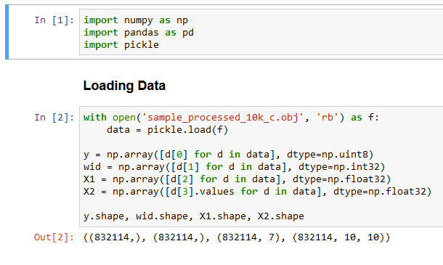
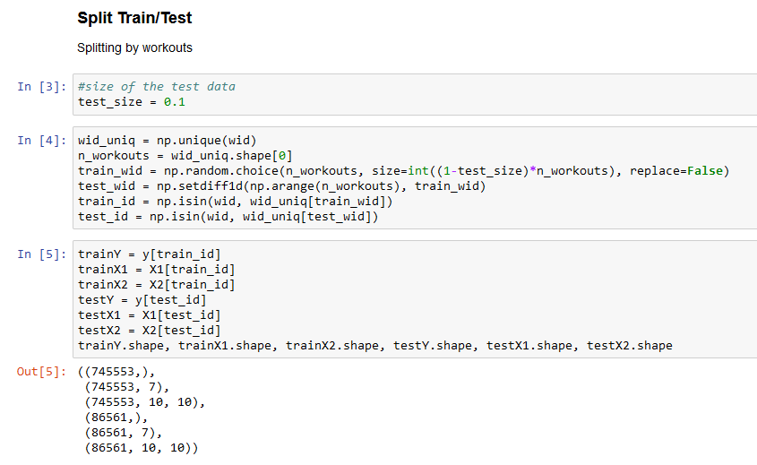
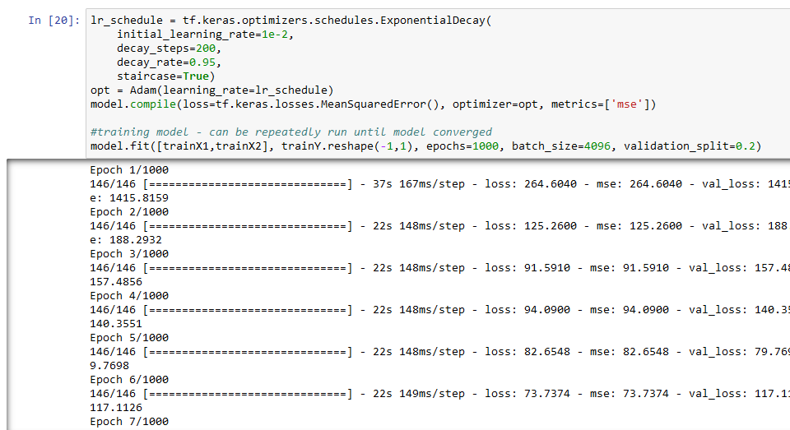

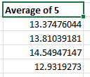
Long Short-Term Model
Input Parameters

Slide 9
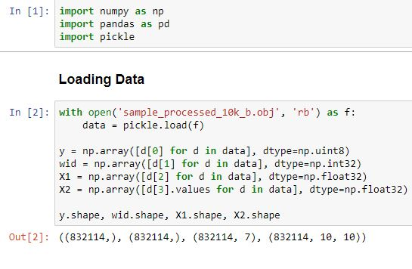
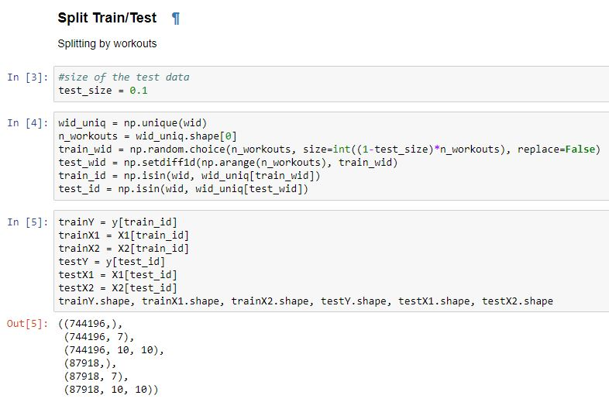
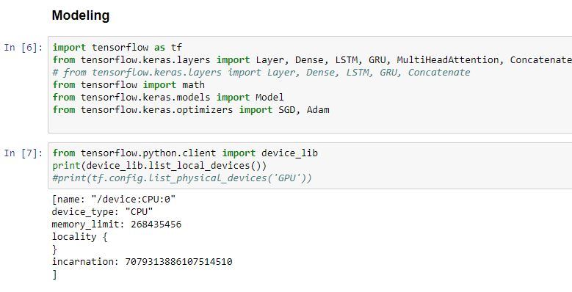
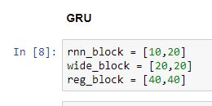
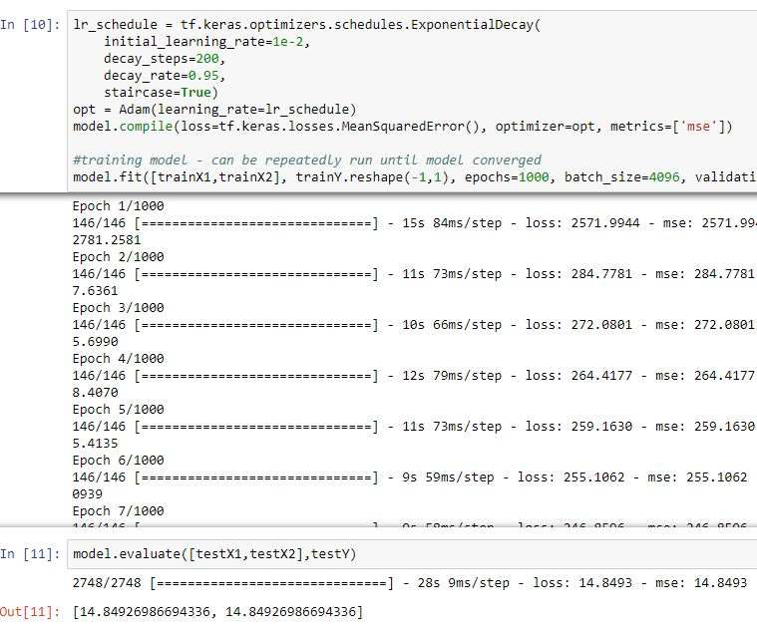
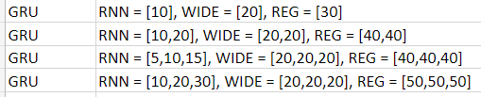
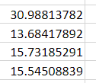
Gated Recurrent Unit
Model type with parameters
Average error

Slide 10
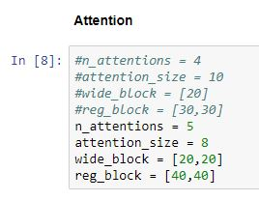
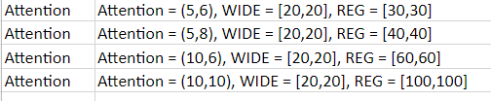
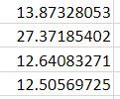
Multi-head Attention
Model type with parameters
Average error

Slide 11
Project Challenges
Original plan
Deviation
Pull together data to convert into an object that can be used by our learning models
Compile output for milestone 2, analyze model and determine what information is needed for milestone 3
Create power point and presentation
Server limitation allowed only around 5 runs at a time.
These restrictions, with permission of our sponsor were altered in terms of the data needed for the models to ensure we could complete it on time.
One member was unavailable for 2 weeks due to life events. They produced their parts earlier and were edited in as the project progressed

Slide 12
Challenges continued...
Pros
Cons
Challenges
Being online has allowed us to work independent of each other while aiding one another
The models once the program was solidified were very self sufficient
Our sponsor aided us by editing the programs to make them run more smoothly
Very different schedules, hard for the entire team meeting up. So, we made sure everyone was responsive in our group chat.
Jupyter will not run model data unless left open. You can not run a model on the server without babysitting it. This caused some pauses in runs.
Finishing all completed models in the allotted time
Cleaning out the errors within the models
Network access prohibited us from accessing the server one weekend so we could not access our models
One member had life events and could not be available for 2 weeks

Slide 13

Next phase
Currently on track to complete milestone 3. This will compare our milestone 2 results with results of more advanced models. The more advanced models are finely tuned for predicting heartrates based on exercise, location, weather and gender. We can see how close our simple models are to these other models.

Slide 14
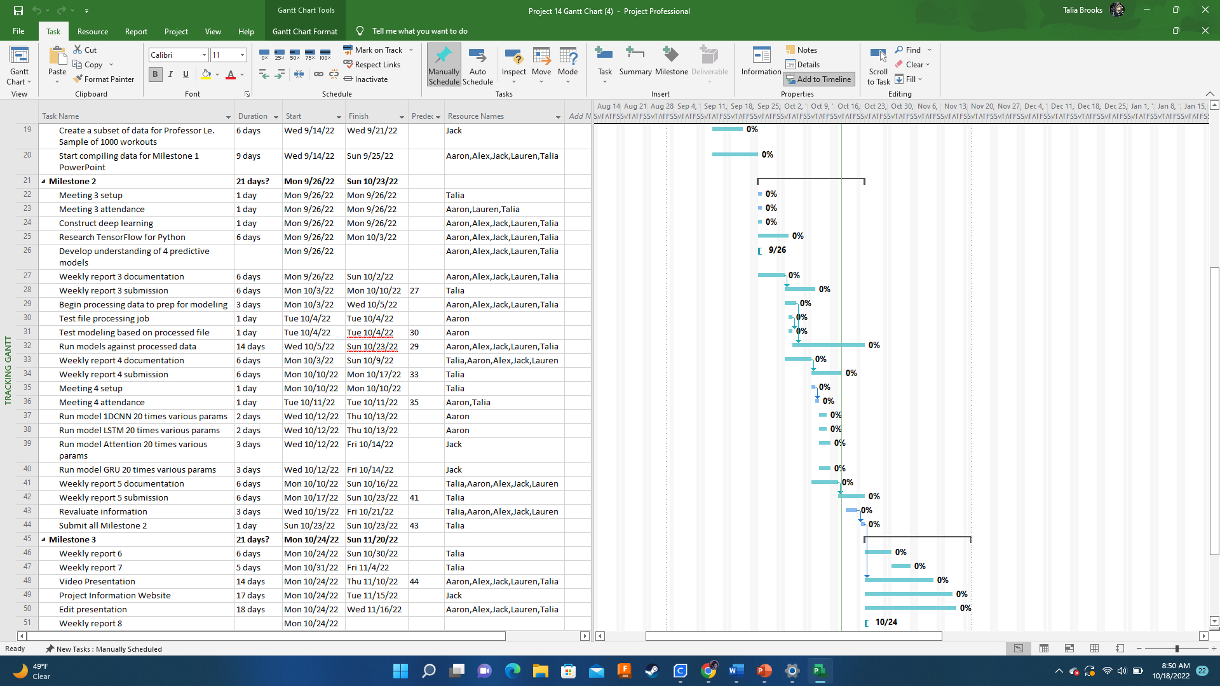
Gantt chart for Milestone 2

Slide 15
References
Jianmo Ni, Larry Muhlstein, Julian McAuley, "Modeling heart rate and activity data for personalized fitness recommendation", in Proc. of the 2019 World Wide Web Conference (WWW'19), San Francisco, US, May. 2019.
FitRec-project. FitRec-Project. (n.d.). Retrieved September 22, 2022, from https://sites.google.com/eng.ucsd.edu/fitrec-project/home‌
“Nominatim.” Nominatim.org, nominatim.org/.
“The Weather’s Record Keeper.” Meteostat, meteostat.net/en/.
Pandas. “Python Data Analysis Library — Pandas: Python Data Analysis Library.” Pydata.org, 2018, pandas.pydata.org/.
Jupyter Project Documentation#. Jupyter Project Documentation - Jupyter Documentation 4.1.1 alpha documentation. (n.d.). Retrieved September 22, 2022, from https://docs.jupyter.org/en/latest/
By: IBM Cloud Education. (n.d.). What is supervised learning? IBM. Retrieved October 21, 2022, from https://www.ibm.com/cloud/learn/supervised-learning
Brownlee, Jason. “1D Convolutional Neural Network Models for Human Activity Recognition.” Machine Learning Mastery, 20 Sept. 2018, machinelearningmastery.com/cnn-models-for-human-activity-recognition-time-series-classification/.
Brownlee, Jason. “A Gentle Introduction to Long Short-Term Memory Networks by the Experts.” Machine Learning Mastery, 19 July 2017, machinelearningmastery.com/gentle-introduction-long-short-term-memory-networks-experts/.
Papers with code - multi-head attention explained. Explained | Papers With Code. (n.d.). Retrieved October 23, 2022, from https://paperswithcode.com/method/multi-head-attention
Kostadinov, S. (2019, November 10). Understanding GRU networks. Medium. Retrieved October 23, 2022, from https://towardsdatascience.com/understanding-gru-networks-2ef37df6c9be
Le, L. (2022, September 27). Modeling Instructions. Linh Le.

